Slide 1

Amiel, Yovel, Yotam, Dima

Slide 2
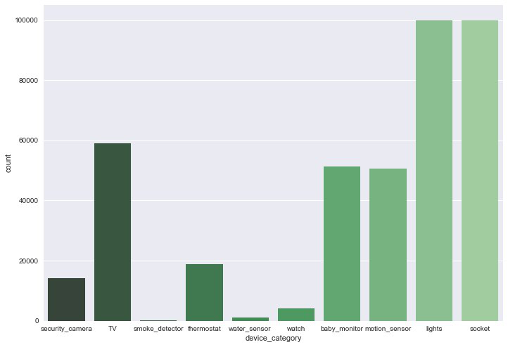
Data Exploration

Slide 3
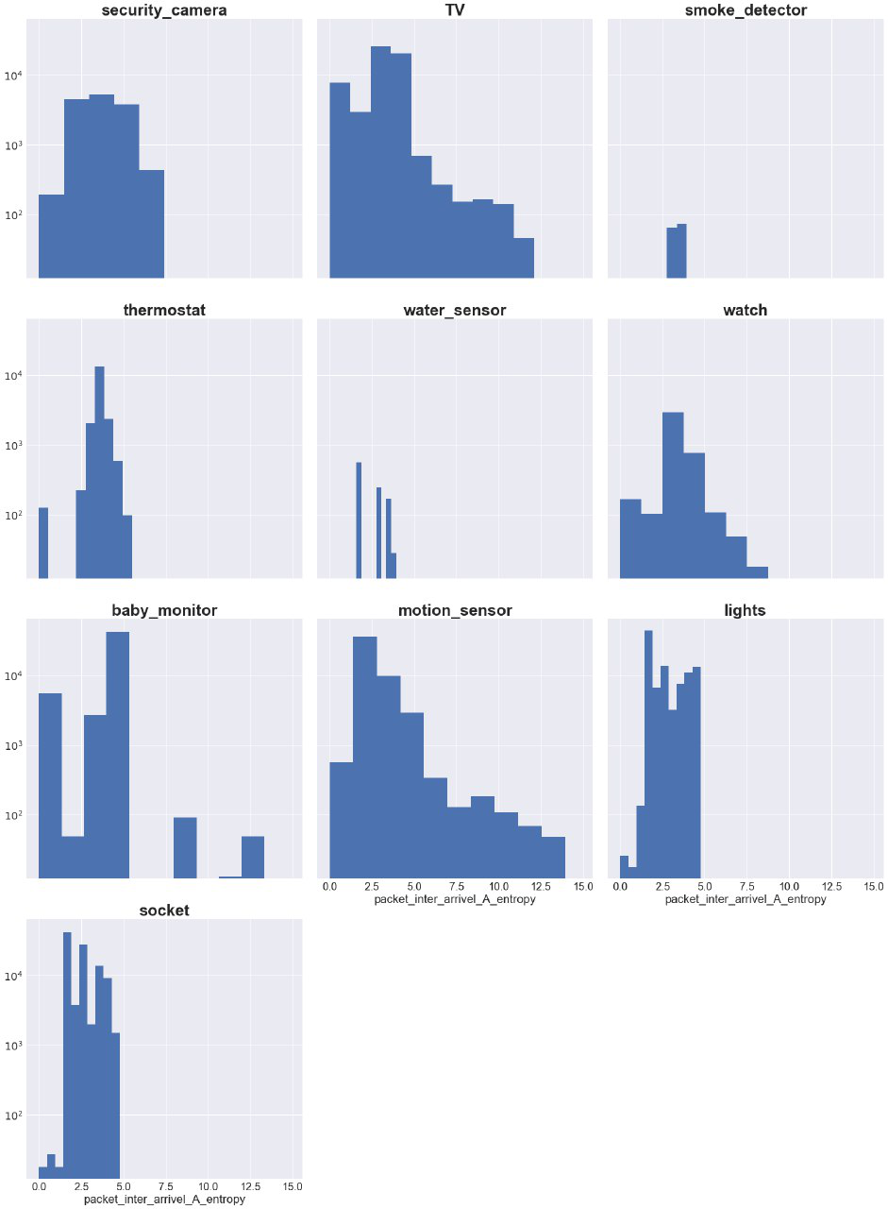
Data Exploration

Slide 4
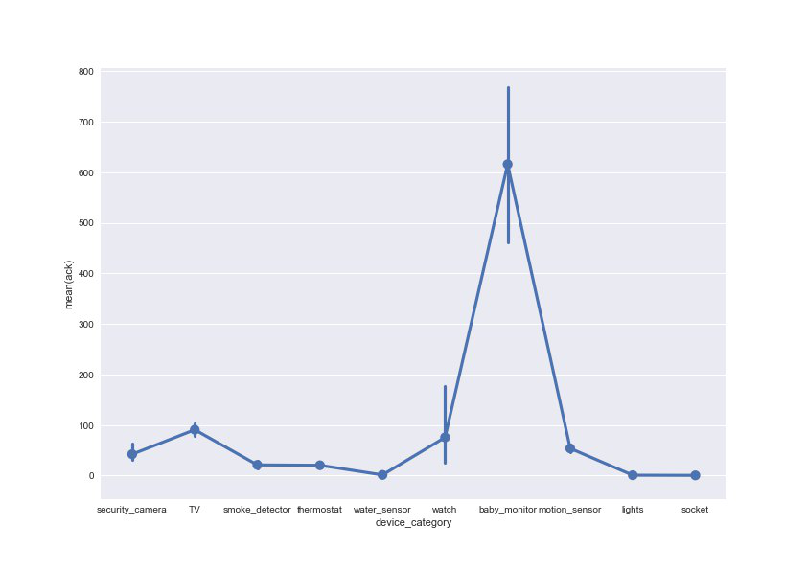
Data Exploration

Slide 5
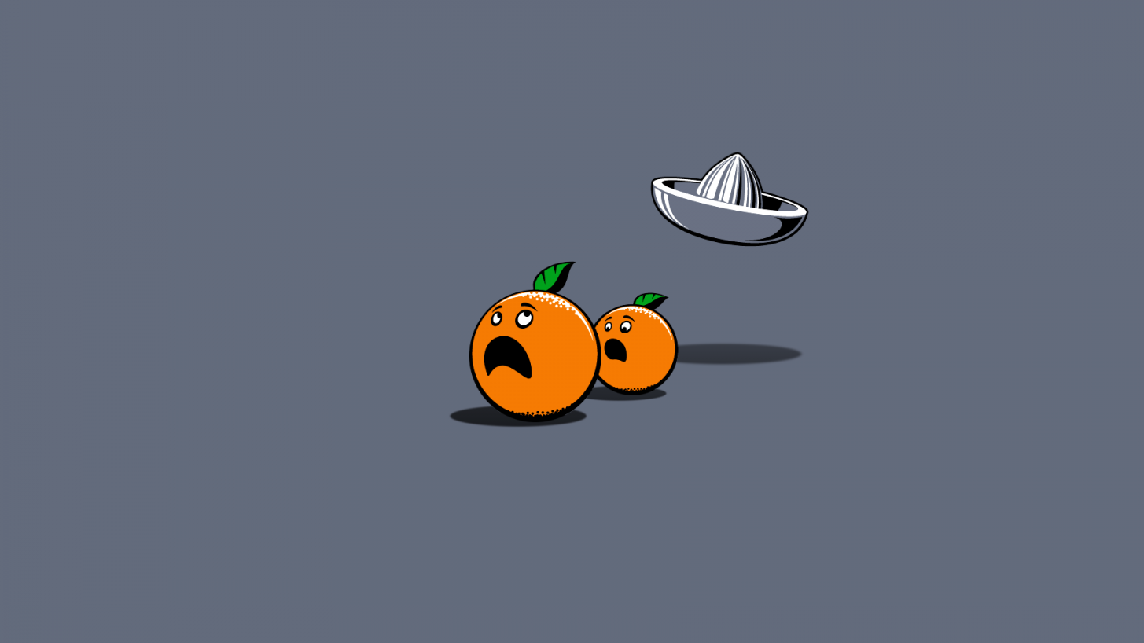
Feature Extraction
258 meta features
Based on insights from data exploration.
Divide features by
“duration”,
“bytes”,
“ttls_avg”

Slide 6
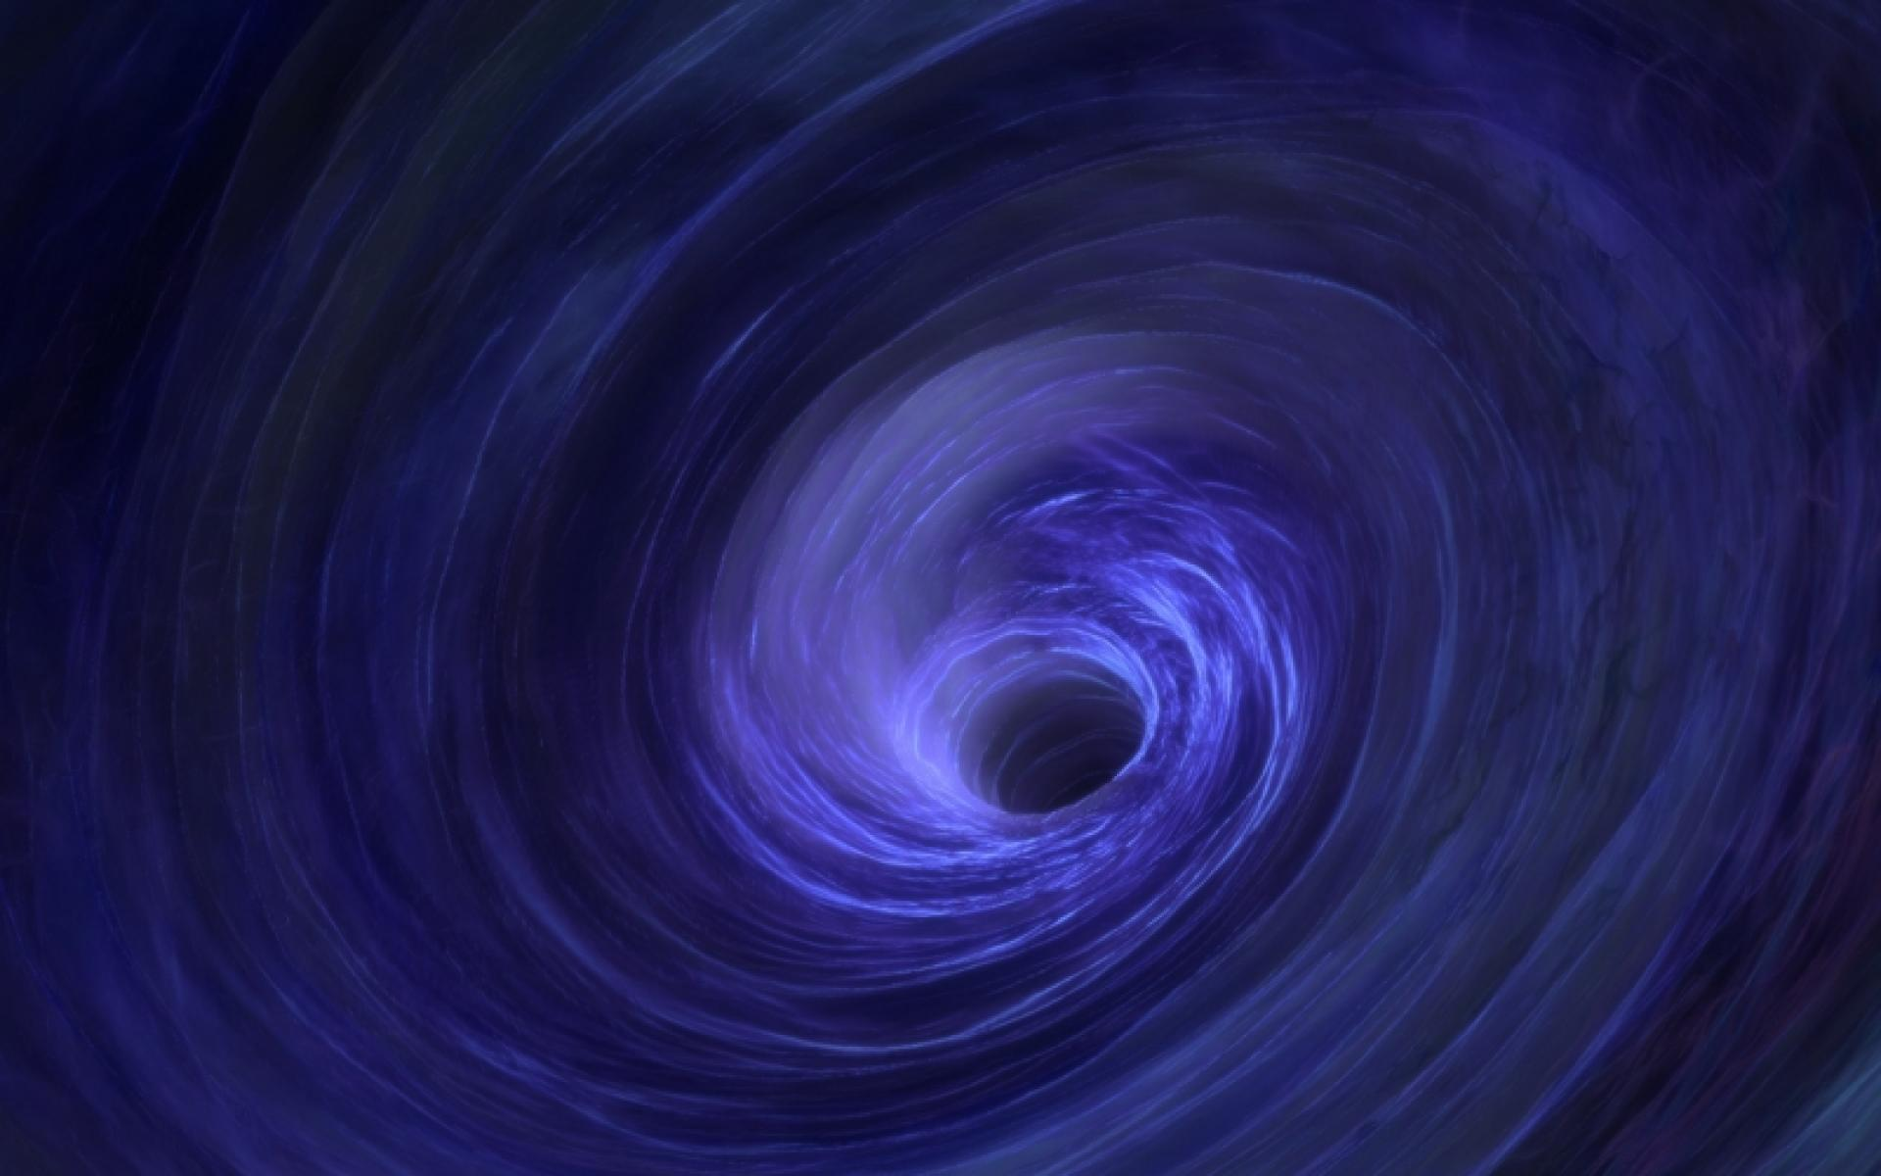
Null Handling
195 instances with null values:
185 without http data , 10 without ssl data
Only 2 classes for instances with null values
125 TV (0.49% from all TV)
70 Security Camera (0.21% from all Security Camera)
Bottom line: Replace nulls with 0’s

Slide 7

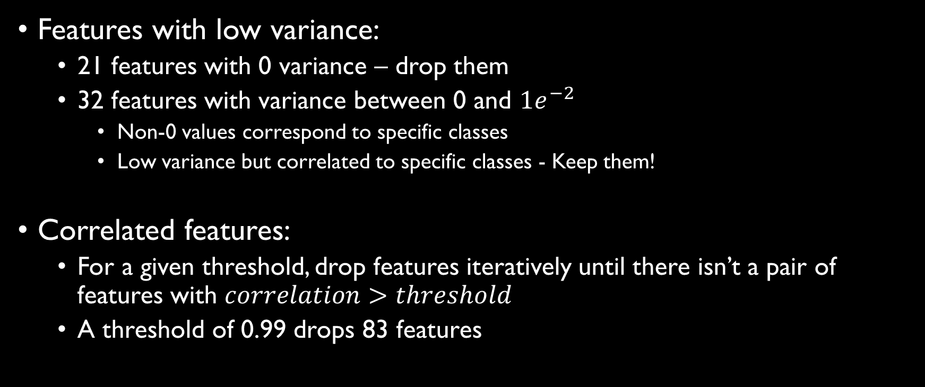
Manual Feature Selection
Features with low variance:
21 features with 0 variance – drop them
32 features with variance between 0 and $1e^{−2}$
Non-0 values correspond to specific classes
Low variance but correlated to specific classes - Keep them!
Correlated features:
For a given threshold, drop features iteratively until there isn’t a pair of features with $correlation>threshold$
A threshold of 0.99 drops 83 features

Slide 8
Automatic Feature Selection
Class-dependent feature selection
Model per class -> Feature selection per class
For each class, select half the features using chi-squared stats
Didn’t improve results

Slide 9
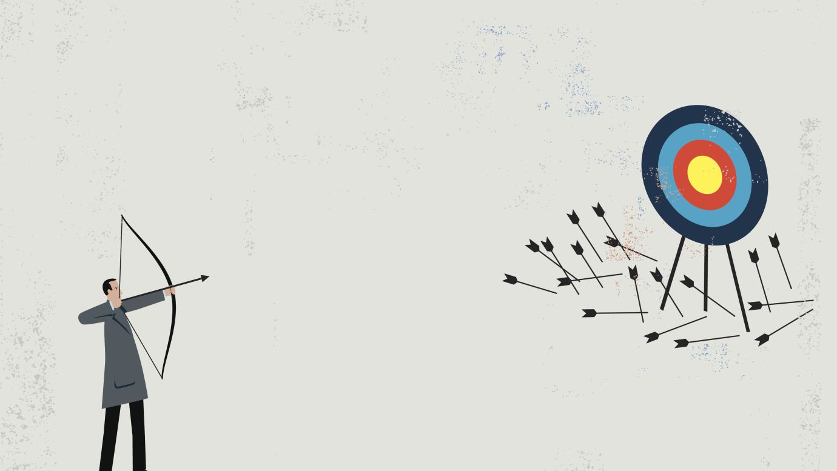
Failures

Slide 10
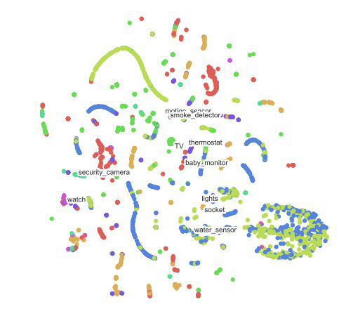
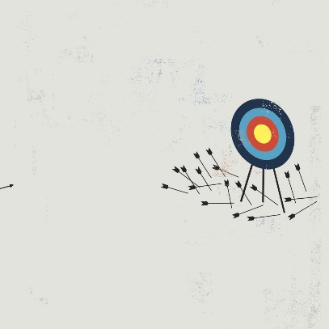
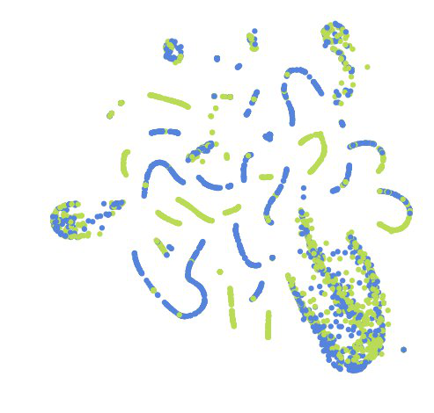
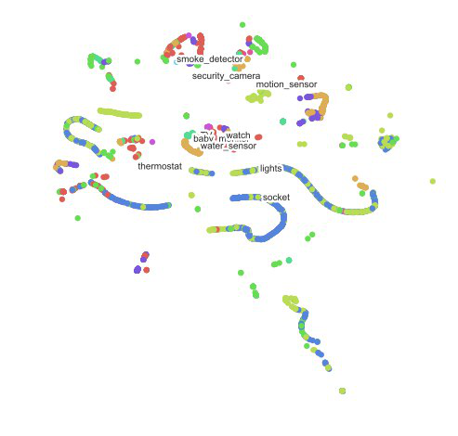
TSNE
TNSE
PCA + TNSE
TSNE on top two classes
Etc.

Slide 11
DBscan
We were unable to cluster the data into meaningful groups.
Clusters could have been used as features.
We didn’t have time to test it...

Slide 12
Meta-Features
Low value.
Significant increase in learning time.

Slide 13


Slide 14
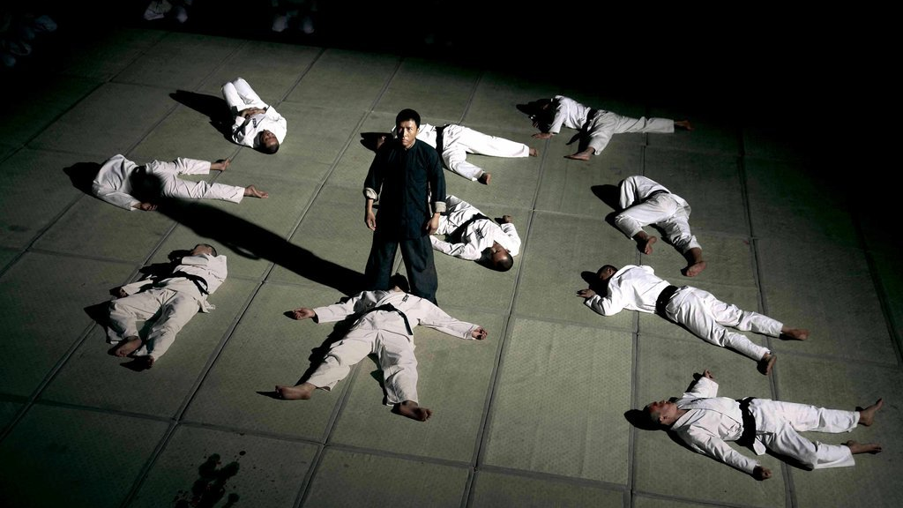
Modeling
One-vs-All Classification
Classifiers need not use same algorithm
Models we used:
Random Forest
XGBoost \ LGBM
Logistic Regression
Ensemble of the above models

Slide 15
Modeling
'socket': RandomForestClassifier(n_estimators=100, min_samples_leaf=3, n_jobs=-1, max_features= 60),
'lights': RandomForestClassifier(n_estimators=100, min_samples_leaf=3, n_jobs=-1),
'TV': lightgbm.LGBMClassifier(min_child_samples=5, min_split_gain=0.01, colsample_bytree=0.9, n_jobs=-1),
'baby_monitor': lightgbm.LGBMClassifier(min_child_samples=5, min_split_gain=0.01, colsample_bytree=0.9, n_jobs=-1),
'motion_sensor': lightgbm.LGBMClassifier(min_child_samples=5, min_split_gain=0.01, colsample_bytree=0.9, n_jobs=-1),
'thermostat': lightgbm.LGBMClassifier(min_child_samples=5, min_split_gain=0.01, colsample_bytree=0.9, n_jobs=-1),
'security_camera': lightgbm.LGBMClassifier(min_child_samples=5, min_split_gain=0.01, colsample_bytree=0.9, n_jobs=-1),
'watch': lightgbm.LGBMClassifier(min_child_samples=5, min_split_gain=0.01, colsample_bytree=0.9, n_jobs=-1),
'water_sensor': RandomForestClassifier(n_estimators=50, min_samples_leaf=3, n_jobs=-1), 'smoke_detector': lightgbm.LGBMClassifier(min_child_samples=5, min_split_gain=0.01, colsample_bytree=0.9, n_jobs=-1)

Slide 16

The dragon has three heads
Random Forest - Trees
XGBoost - Boosting
Logistic Regression – Weights

Slide 17

Class Balancing
Weighting
We tried different weight combinations (didn’t work ☹).
Resampling
Balance train data for each classifier separately
Sample balanced subset of dataset
50 % given class
50% other classes (unknown)

Slide 18

Local Validation
Stratified 5-Fold Validation
Problem: Test is perfectly balanced.
Solution: Validation for each fold was balanced to have 34 examples for each class (0.2 * # of samples from smallest class).

Slide 19

Special Insights
Perfectly balanced test → forced balanced predictions.
Sorted predictions by score from all 10 models together.
For each class we accepted the 100 most confident predictions.
Sample is classified as only one class.

Slide 20
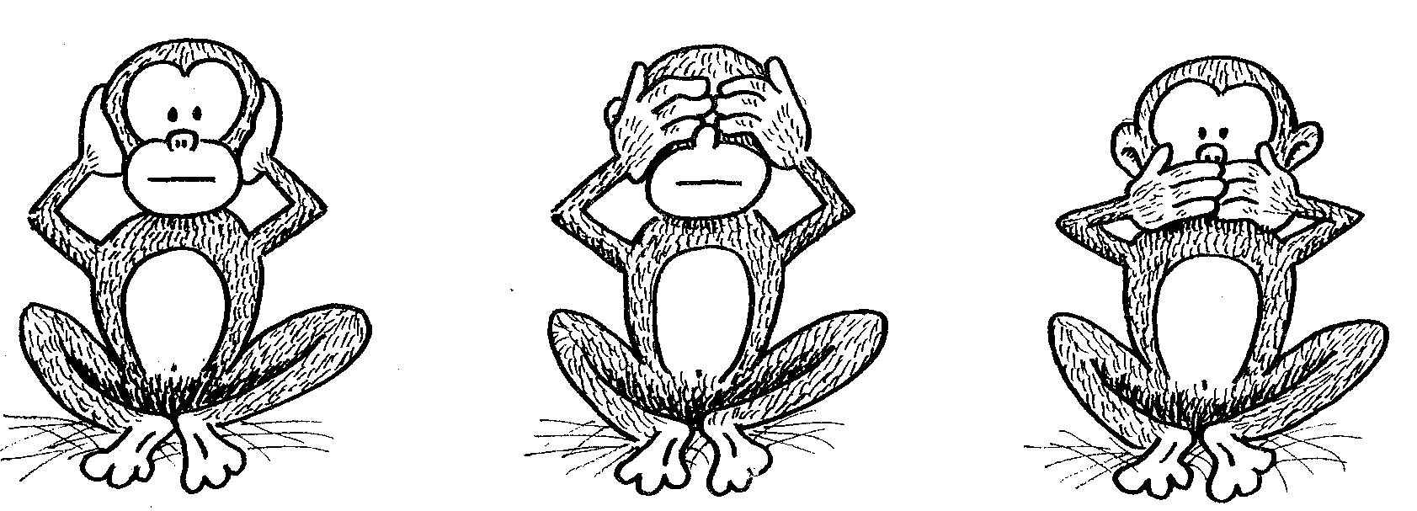
Three Evil Classes
_{Water Sensor Lights Socket}

Slide 21
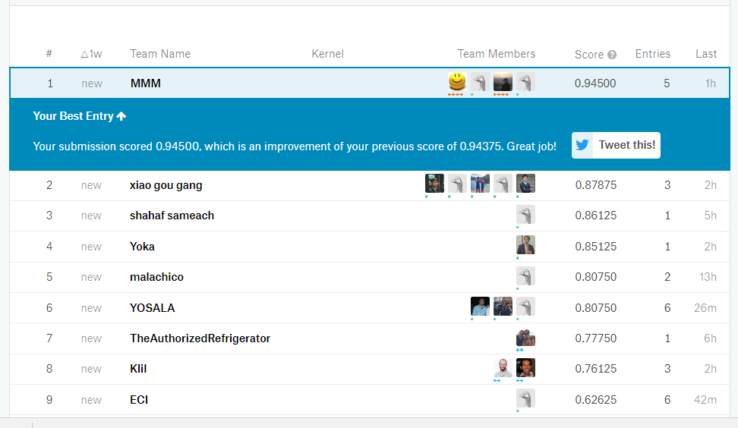

Slide 22
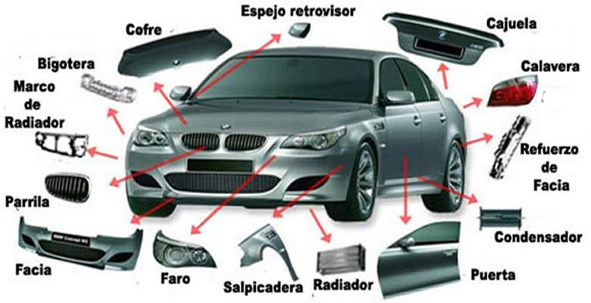
Possible Improvements

Slide 23

Improvement Ideas
Hyper Parameter Tuning using grid search, hill climbing etc.
Augmentation
Gaussian noise
GANs

Slide 24

Feature Extraction Improvements
Last layer of autoencoder
Larger search space for meta-features
aggressive feature selection

Slide 25
Feature Extraction
Larger search space for meta-features → aggressive feature selection
Last layer of an autoencoder

Slide 26
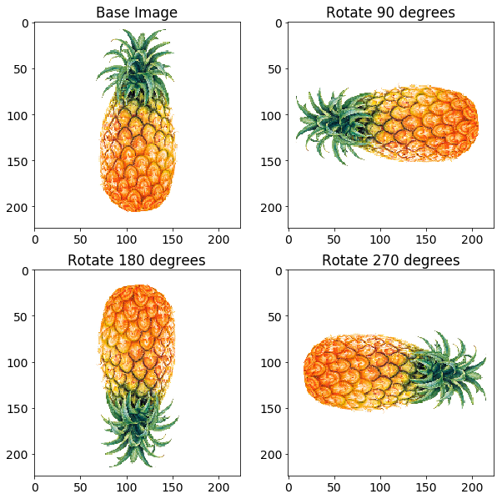
Data Augmentation
Improve generalization and mitigate class imbalance
Methods:
Gaussian noise
GANs for under-represented classes

